Slide 1
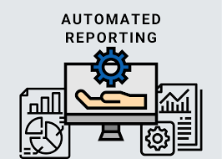
CIS215 Foundations of Data Analytics and Programming Instructor: Chris Santo Module #3 Data Transformation Tutorial Sales Report Automation (Textbook pg. 82-113) Assignment Walkthrough

Slide 2
M3: Data Transformation (Sales Report Automation) KNIME Assignment
In this tutorial, you will impersonate the role of a business analyst working for a UK-based online retailer, selling all-occasion gifts.
You are intrigued by data analytics and are reading a few (good) books about its potential.
You have set for yourself the ambition of progressively amplifying the role of data analytics in the company by leveraging your new skills.
You decide to start from something relatively simple: Automate and improve the reporting of sales data.
By doing so, you want to make a quick and visible impact and instill an appetite for more advanced analytics in your colleagues and managers, unlocking interest and investments.

Slide 3
M3: Data Transformation (Sales Report Automation) KNIME Assignment
The company you work for has grown quickly and didn't have the opportunity to adopt a sustainable business intelligence solution.
The regular reporting is managed manually using Excel. The poor finance analyst responsible for it pulls data from the company website every Friday and, after a couple of hours of boring manual steps, sends an email with the latest status.
Due to the manual nature of the activity, the reports are prone to human error, and almost every week this causes several back-and-forth emails, which leave no time for identifying business-meaningful patterns in the data and creating real value.
You empathize with the finance analyst and decide to set aside a few hours to automate the full reporting process in KNIME.

Slide 4
M3: Data Transformation (Sales Report Automation) KNIME Assignment
First of all, you manage to retrieve a list of the most important business questions people ask about sales evolution.
This initial list will be a good base for your initial endeavor:
What are the top ten products in our assortment, meaning the ones that generate the most significant number of sales?
What are the top three products within each subcategory?
To which country do we sell the most?
During the current calendar year to date, how much revenue was generated within each product category?
What's the relative footprint of each category out of the total portfolio of products for the current year?
In which months should we expect a peak in sales for our seasonal categories?

Slide 5
M3: Data Transformation (Sales Report Automation) KNIME Assignment
You decide that your first automated report shall include a tabular view answering the first five business questions appearing on the prior slide.
For the last one, since the seasonal behavior of the business is not going to change significantly on a weekly basis, it will be enough to build a chart that depicts the patterns of sales by month as a one-off exercise.
Having defined the minimum set of deliverables that your work should cover, you are ready to go to the next step and assess what data is required to make it happen.

Slide 6
M3: Data Transformation (Sales Report Automation) KNIME Assignment
With the help of the finance analyst, who is already getting very excited about your initiative, you retrieve the latest data required for the regular sales reporting and discover that it is scattered across three different tables and four different files:
Product Master Data (in CSV file productMD.csv)
Customer Master Data (in CSV file customerMD.csv)
Sales Transactions (in Excel file TransactionL3M.xlsx) (in Excel file TransactionsHistory.xlsx)

Slide 7
M3: Data Transformation (Sales Report Automation) KNIME Assignment
Product Master Data (in CSV file productMD.csv)
This includes a unique alphanumeric code (column StockCode), which serves as a product ID, a short Description, and two columns to locate each item within the two-level product hierarchy used in the company, namely Category and Subcategory.
For example, within the category "Stationery," we find the subcategories "Notebooks" and "Stickers," while within "Home," we have "Clocks" and "Furniture."

Slide 8
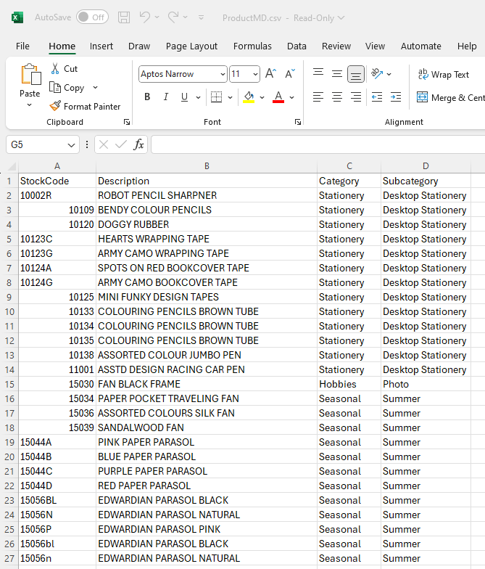
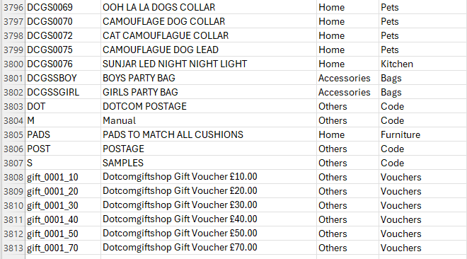
Product Master Data (in CSV file productMD.csv)
A quick glance at the file in Excel reveals the following:
This file has 3,812 rows and 4 columns or fields.
In case you’re wondering why the last row is numbered 3,813 and we’re saying there are 3,812 rows: We don’t count the header row when we count the number of rows.

Slide 9
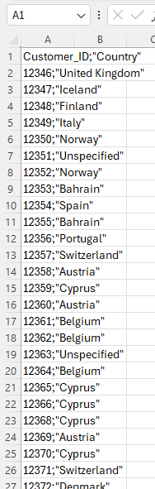
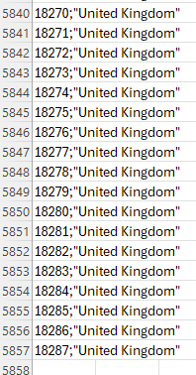
M3: Data Transformation (Sales Report Automation) KNIME Assignment
A quick glance at the file in Excel reveals the following:
This file has 5,856 rows and 2 columns/fields.
The file appears to be a semicolon-separated file. Note the semicolons that separate the data for the two fields in each row.
Customer Master Data (in CSV file customerMD.csv)
For each customer who has signed up to the website, it includes an identifier (Customer_ID) and the Country of residence.

Slide 10
M3: Data Transformation (Sales Report Automation) KNIME Assignment
Sales Transactions (in Excel file TransactionL3M.xlsx)
This is the biggest table as it records all sales. For every invoice (identified with column Invoice_ID), this table can host multiple rows, one for each product (described through its StockCode) included within the transaction.
For each row, we also have the number of purchased items (Quantity), the unit Price, the Customer_ID (which can be empty, if the customer hasn't signed up), and a string describing the date and time of the purchase (Invoice_time).

Slide 11
M3: Data Transformation (Sales Report Automation) KNIME Assignment
Sales Transactions (in Excel file TransactionL3M.xlsx) (in Excel file TransactionsHistory.xlsx)
The product and customer master data tables are available in two text files (named productMD.csv and customerMD.csv) extracted from the order management system.
Transactions are stored, instead, in two separate Excel files (TransactionL3M.xlsx and TransactionsHistory.xlsx): the first one contains only the most recent sales, covering the latest three months of transactions, while the second one has the remainder of the transactions' history.

Slide 12
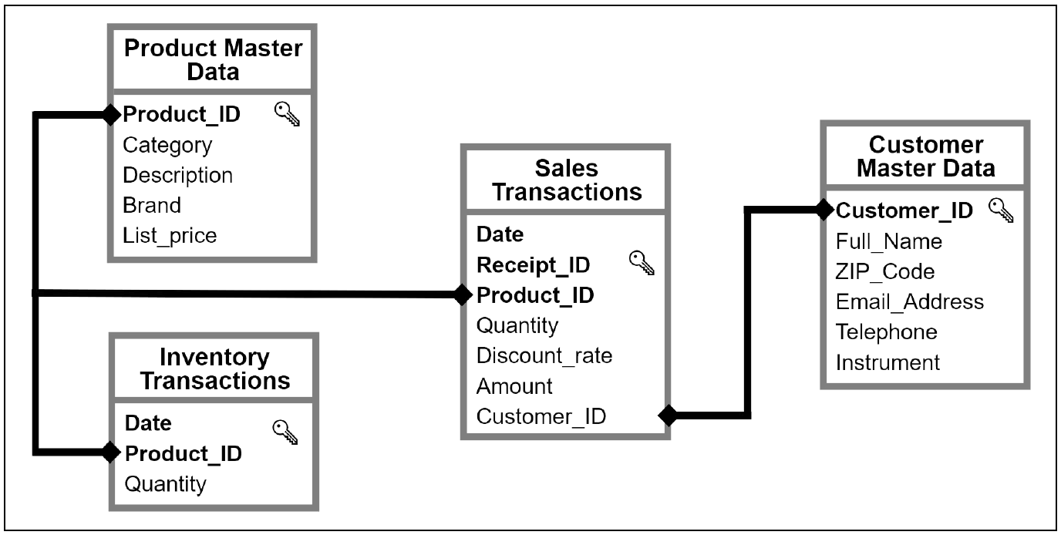
M3: Data Transformation (Sales Report Automation) KNIME Assignment
Figure 3.11 (pg. 84): An Entity-Relationship diagram of the online retailer database

Slide 13
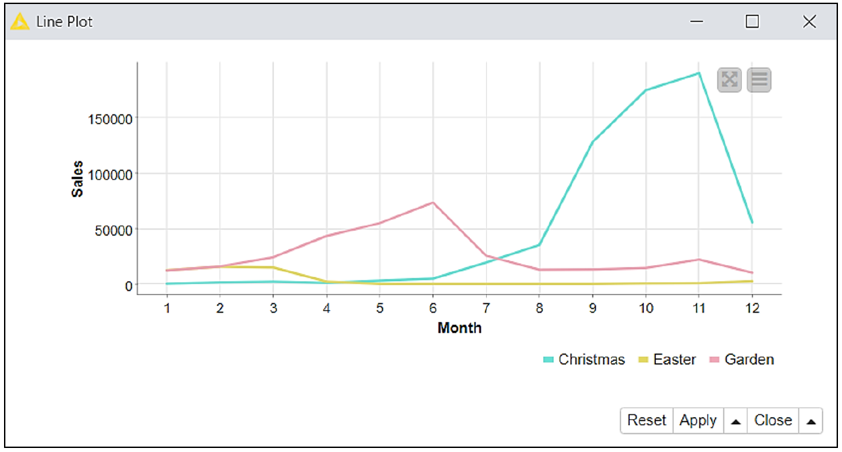

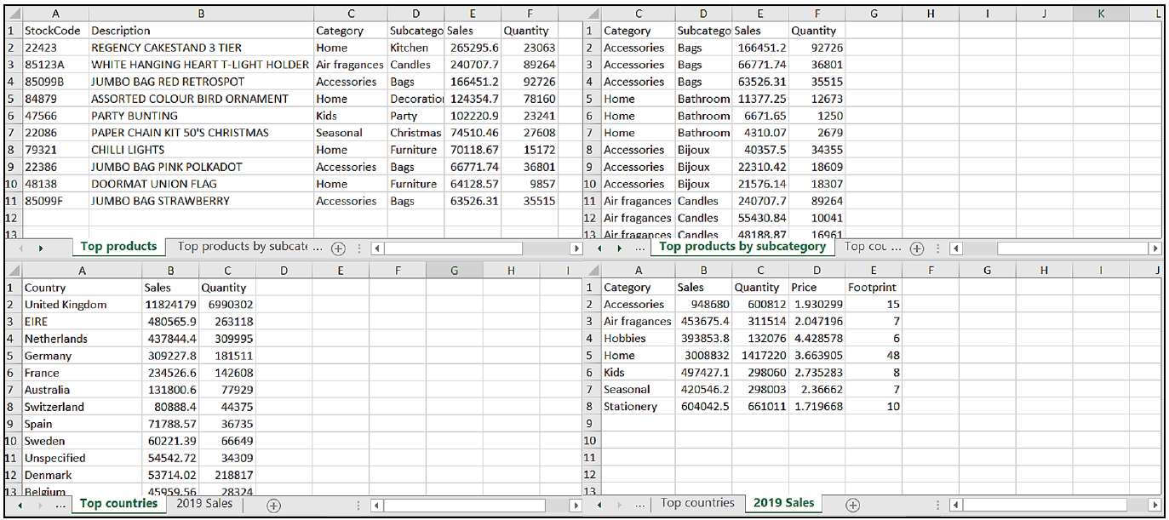
Sales Automation – ETL Process
Image Writer:
Seasonality Chart (.svg)
Excel File: Four-Tab Output Report
Comma Separated Files:
productMD.csv, customerMD.csv Excel Files: TransactionL3M.xlsx, TransactionHistory.xlsx
KNIME Workflow
1. Extract Data from the four files
2. Transform Data various ways as described in the instructions.
3. Load Data to Seasonality.svg and MyReports.xlsx

Slide 14
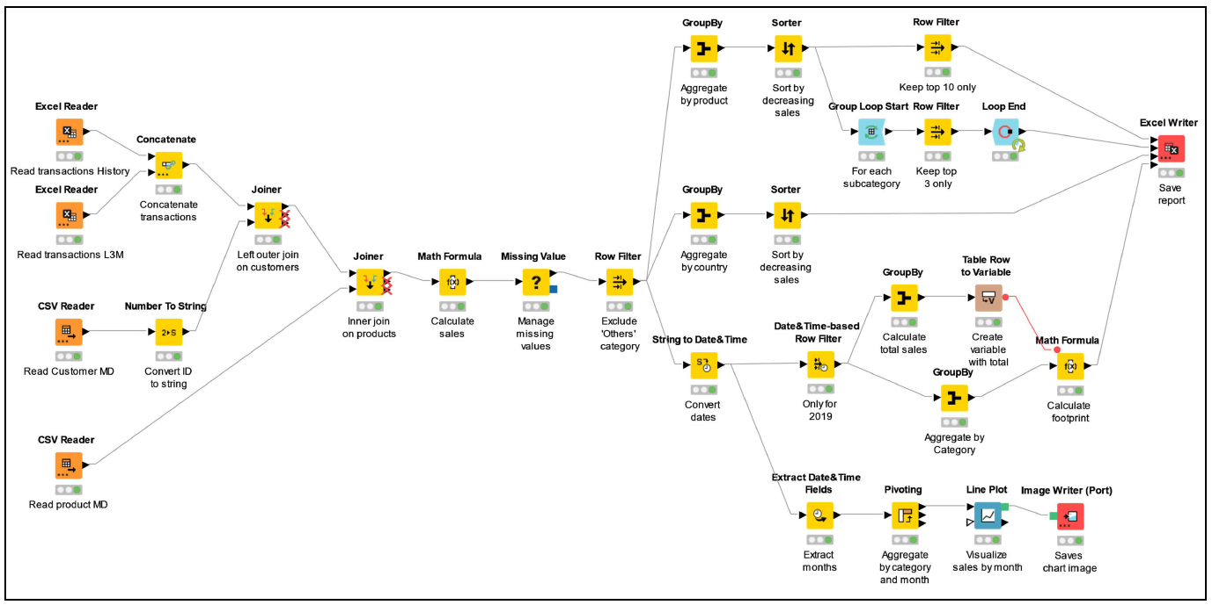
M3: Data Transformation (Sales Report Automation) KNIME Assignment
“Begin with the end in mind. Start with a clear understanding of your destination” -- Stephen R. Covey
Below is the final KNIME workflow, Figure 3.34 on pg. 113 of the text

Slide 15
M3: Data Transformation (Sales Report Automation) KNIME Assignment
There are 29 steps to build the workflow. Ready to begin?
Switch to PDF of textbook starting on textbook pg. 84.
(PDF pg. 109)

Slide 16
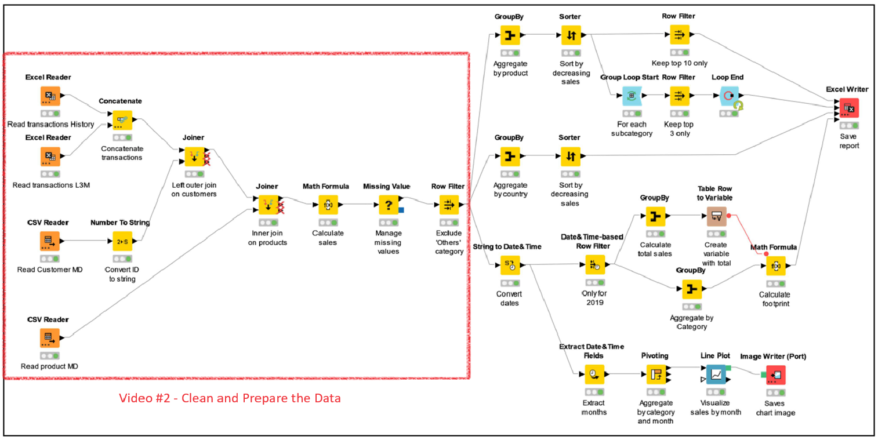
M3: Data Transformation (Sales Report Automation) KNIME Assignment
These are the nodes we will build in the next video. Video #2 – Clean and Prepare the Data (Steps 1-10, pgs. 84-90)

Slide 17
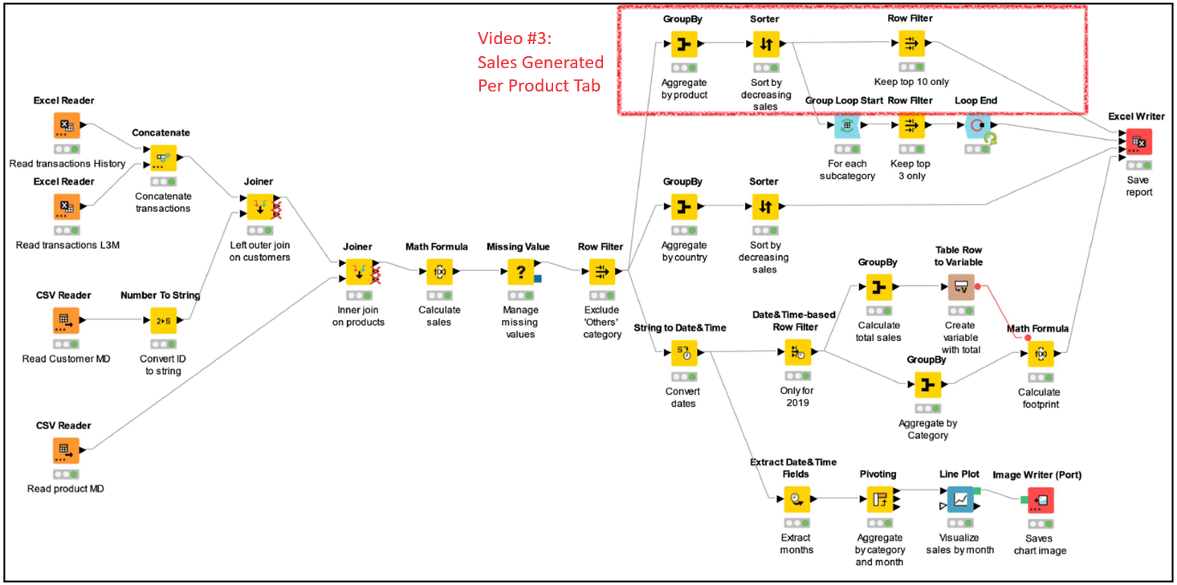
M3: Data Transformation (Sales Report Automation) KNIME Assignment
Video #3 – Excel Tab 1 of 4: Sales Generated per Product (Steps 11-13, pg. 91 only)

Slide 18
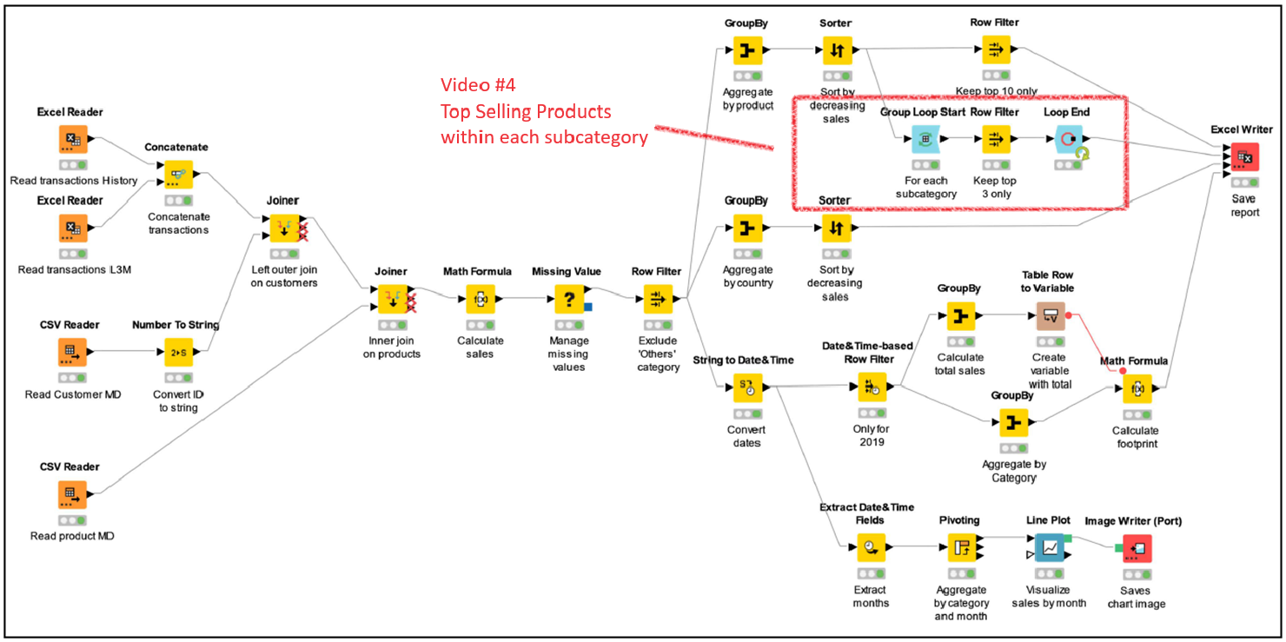
M3: Data Transformation (Sales Report Automation) KNIME Assignment
Video #4 – Excel Tab 2 of 4: Top Selling Products in each Subcategory (Steps 14-16, pgs. 92-96)

Slide 19
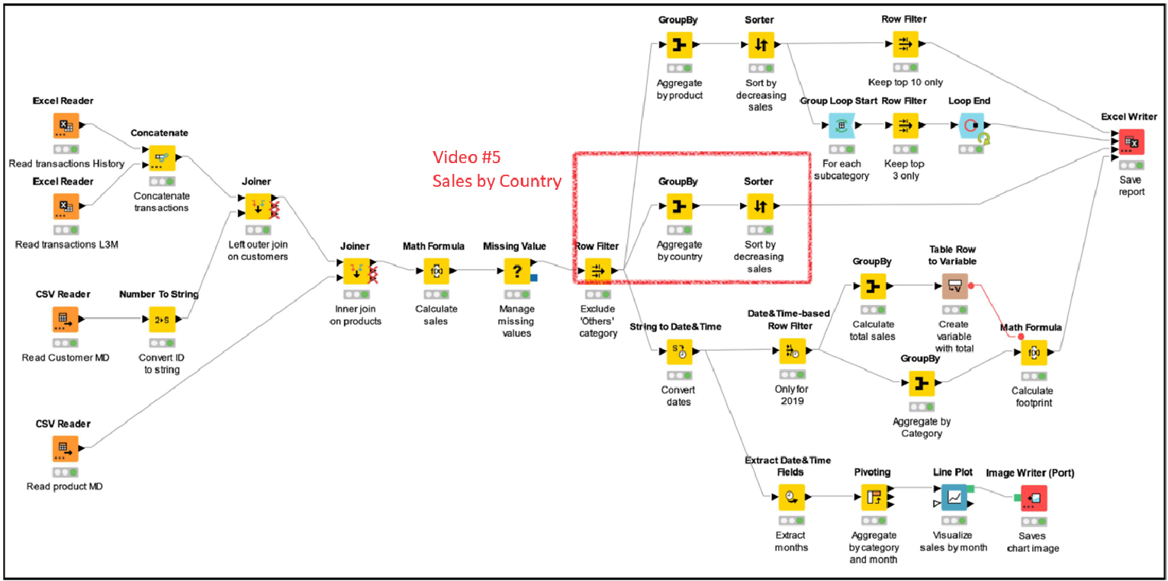
M3: Data Transformation (Sales Report Automation) KNIME Assignment
Video #5 – Excel Tab 3 of 4: Sales by Country, Sorted (Steps 17-18, pgs. 96-97)

Slide 20
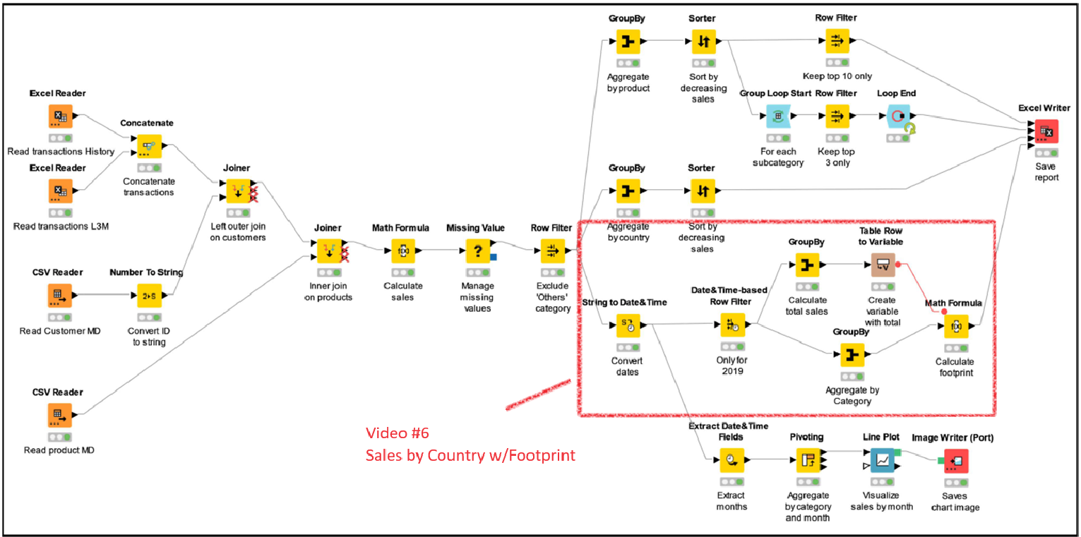
M3: Data Transformation (Sales Report Automation) KNIME Assignment
Video #6 – Excel Tab 4 of 4: Sales by Category w/Footprint (Steps 19-24, pgs. 98-105)

Slide 21
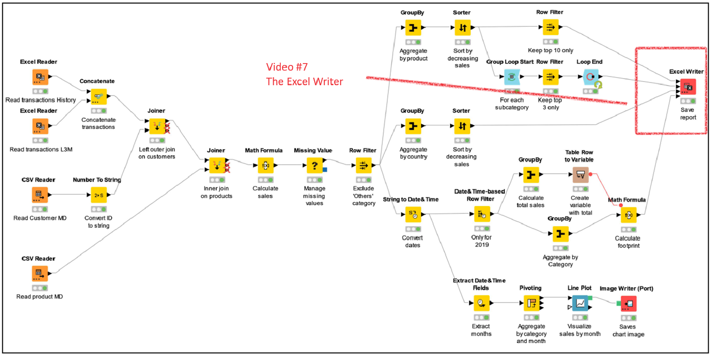
M3: Data Transformation (Sales Report Automation) KNIME Assignment
Video #7 – The Excel Writer Node (Step 25, pgs. 106-107)

Slide 22
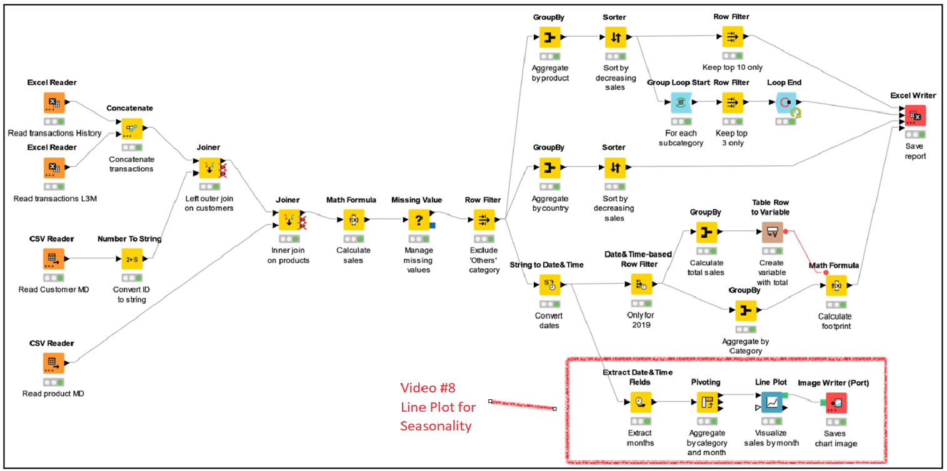
M3: Data Transformation (Sales Report Automation) KNIME Assignment
Video #8 – Line Plot for Seasonality (Steps 26-29, pgs. 108-112)

